Slide 1
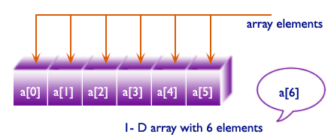
Program to store elements in an array and print it.

Slide 2
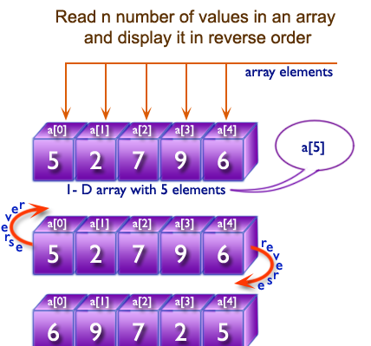
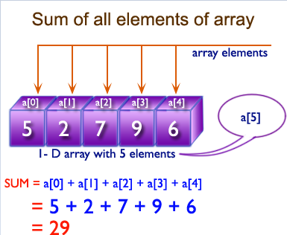
Program to read n number of values in an array and display it in reverse order.

Slide 3
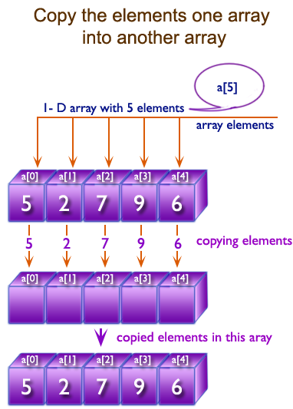
Program to copy the elements one array into another array.

Slide 4
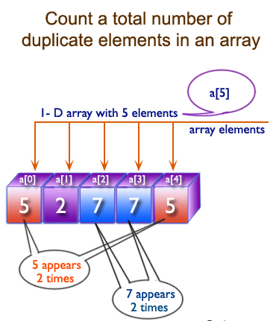
Program in C# Sharp to count a total number of duplicate elements in an array

Slide 5
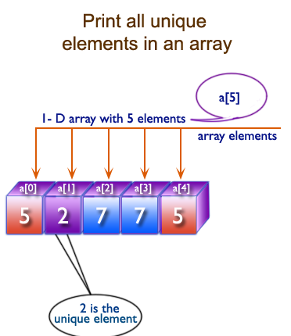
Program in C# Sharp to print all unique elements in an array.

Slide 6
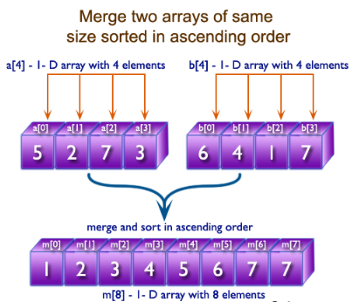
Program to merge two arrays of same size sorted in ascending order

Slide 7
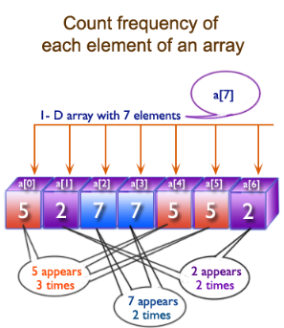
Program to count the frequency of each element of an array.

Slide 8
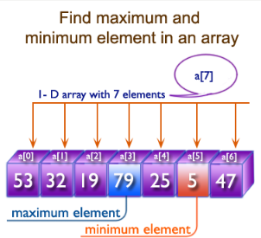
Program to find maximum and minimum element in an array.

Slide 9
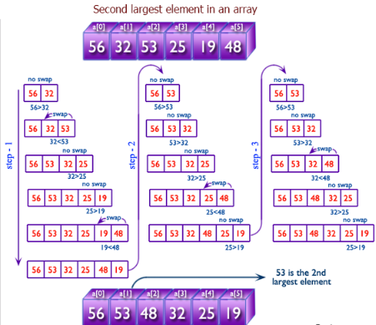
Program to find the second largest element in an array.

Slide 10
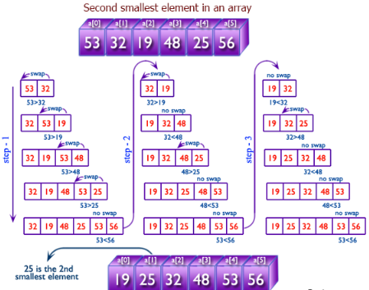
Program to find the second smallest element in an array.

Slide 11
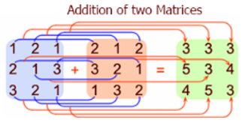
Program for addition of two Matrices of same size..

Slide 12
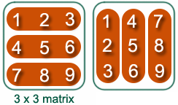
Program to find transpose of a given matrix

Slide 13
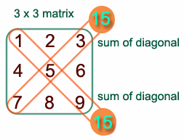
Program to find the sum of left diagonals of a matrix.

Slide 14
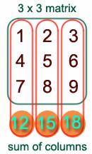
Program to find the sum of rows and columns of a Matrix.

Slide 15
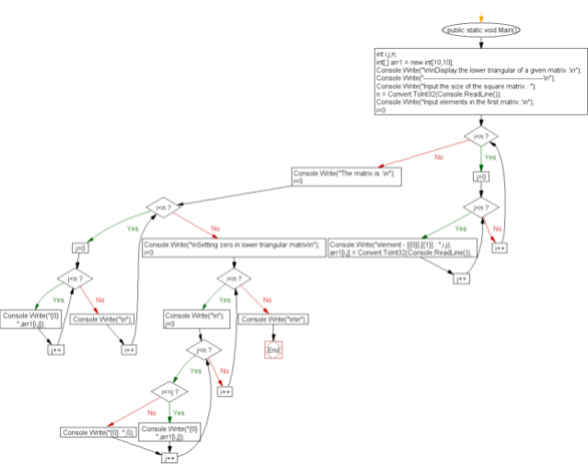
Program to print or display the lower triangular of a given matrix

Slide 16
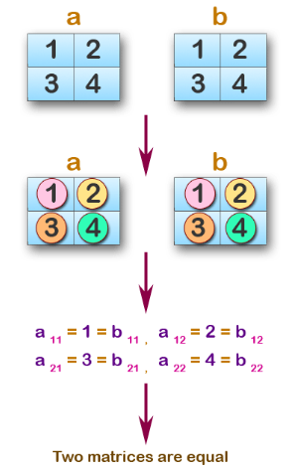
Program to accept two matrices and check whether they are equal.

